Slide 1

Portfolio Website
ELLIE CHEN
Coder Academy - 24/09/2019
Image source: Screenshot of Balsamiq Wireframes

Slide 2
Design Brief & Decisions
Simple layout for easy navigation & better readability
Various fun features to engage audience
Demonstrate my web development skills to prospective employers

Slide 3
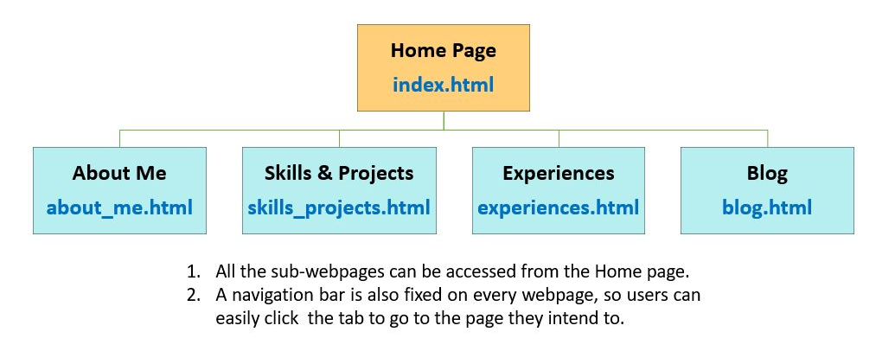
Sitemap

Slide 4
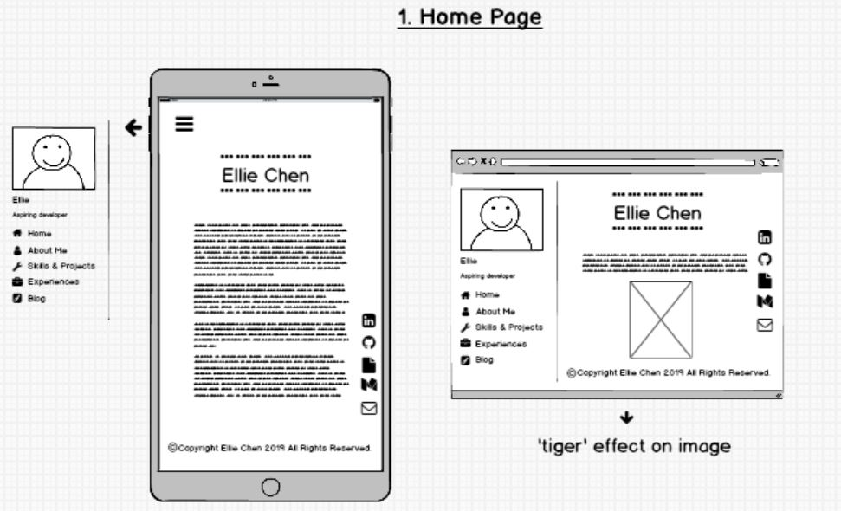
Home - Tiger Effect
Image source: wireframe_1_home

Slide 5
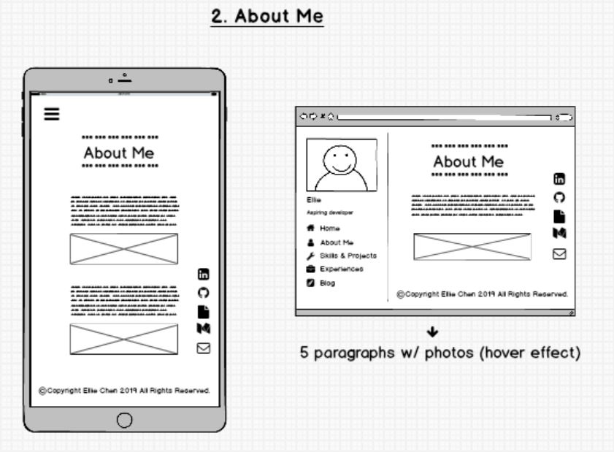
About Me - Zoom in Effect
Image source: wireframe_2_about_me

Slide 6
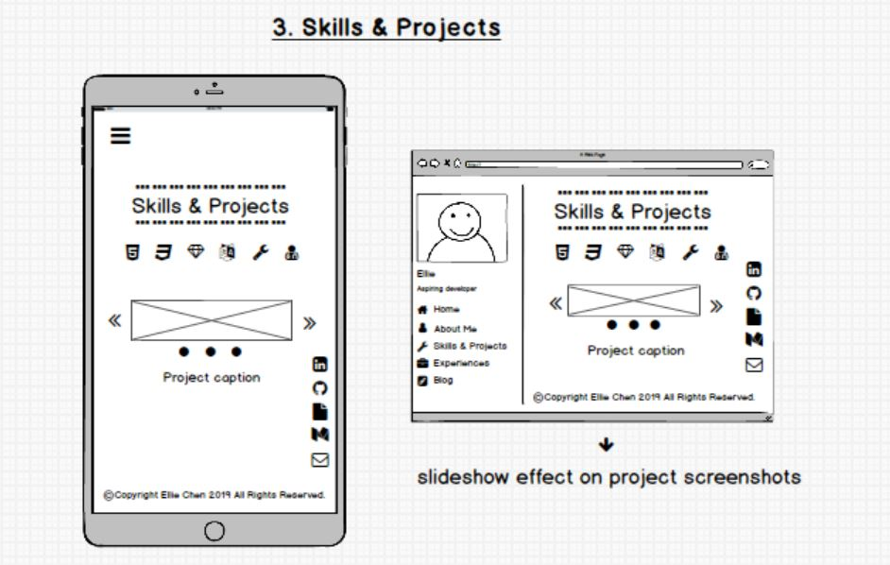
Skills & Projects - Slideshow Effect
Image source: wireframe_3_skills_projects

Slide 7

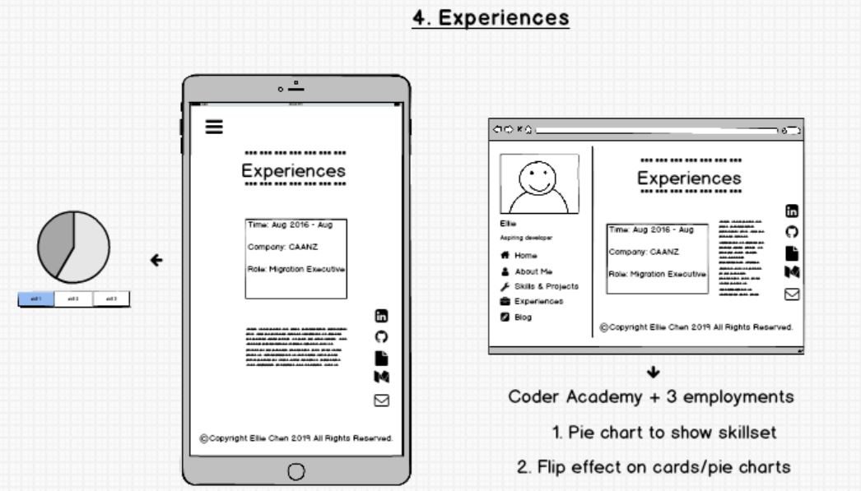
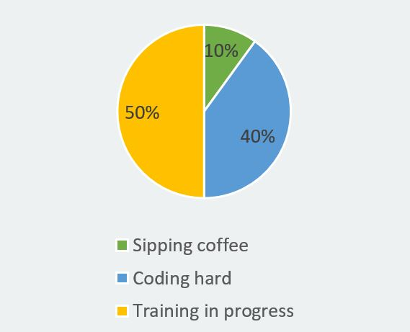
Experiences - Flipping Effect
Image source: wireframe_4_experiences

Slide 8
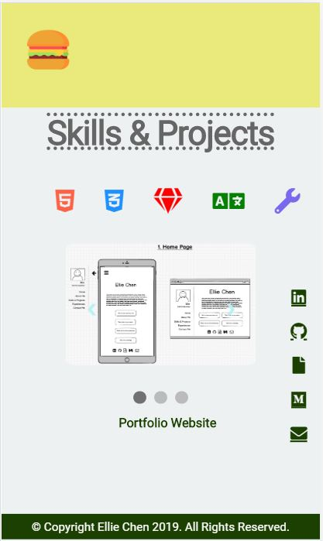
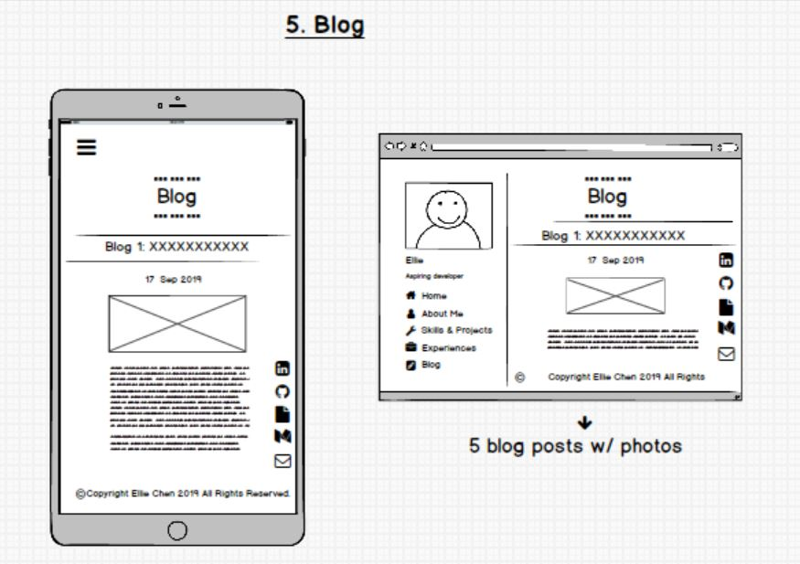
Blog – Resizable Nav Bar | Fixed Contact Icons
Image source: wireframe_5_blog

Slide 9
Reflection
What I enjoy most?
What I struggle most with?
What I would do differently next time?
Notes:
Enjoy
Implementing ideas
Struggle
HTML structures
Wish there could be more smaller CSS challenges (like positioning text & images) before starting the project
How not to break your code (after you build up several pages)
Next time
Start with docs (but leave the features part later, as might not be able to implement it)
Will write down all the html structures first (header, footer, divs, divs inside divs ), then would be easier to use flexbox for positioning

Slide 10

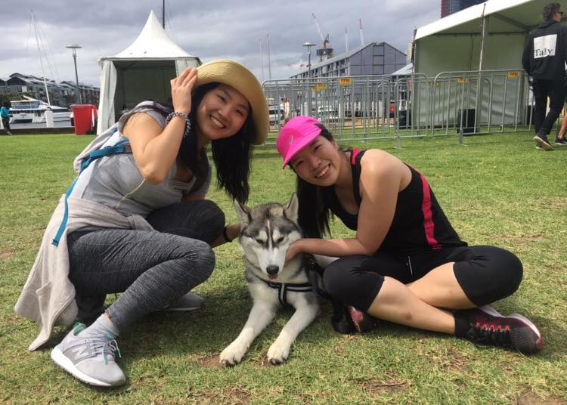
Questions? ^ ^
Image source: my friend’s dog - Hunter

